Slide 1
UUNGULA WIND FARM: COMMUNITY CONSULTATIVE COMMITTEE
Company Update – November 2023

Slide 2

AGENDA
Previous meeting minutes
Project update
Terms of Reference
Environmental approval conditions
Community Engagement update
Community benefit initiatives
Meeting frequency/ general business

Slide 3
1. Previous Meeting Minutes
Minutes distributed

Slide 4
Project update and handover
Matt Flower
Milestones – financial close and Notice to Proceed
Project moving from development to delivery division
New Project Manager and team
Handover

Slide 5
2. Project Update – Early Works
Dan Banovic
Preferred contractor/Joint Venture - GE Renewable Energy Australia Pty Ltd , Consolidated Power Projects Australia & Nacap Pty Ltd known as GECNJV.
Contractor commenced Early Works 11 Aug 23, with early design for civil and electrical packages.
Investigative works commenced onsite on 19 Sep 23.
Working with TfNSW to finalise Twelve Mile Road & Goolma Road Intersection.
Project Traffic Management Plan (V4) with NSW DPE for review.
Notice to Proceed scheduled for 18 Dec 2023.
Christmas / New Year closure 22 Dec 23 to 8 Jan 24.
Public Road works for Twelve Mile Road commence mid-January 2024.
Includes Uungula Rd Intersection and Ilgingery Rd, completion Q3 2024.

Slide 6
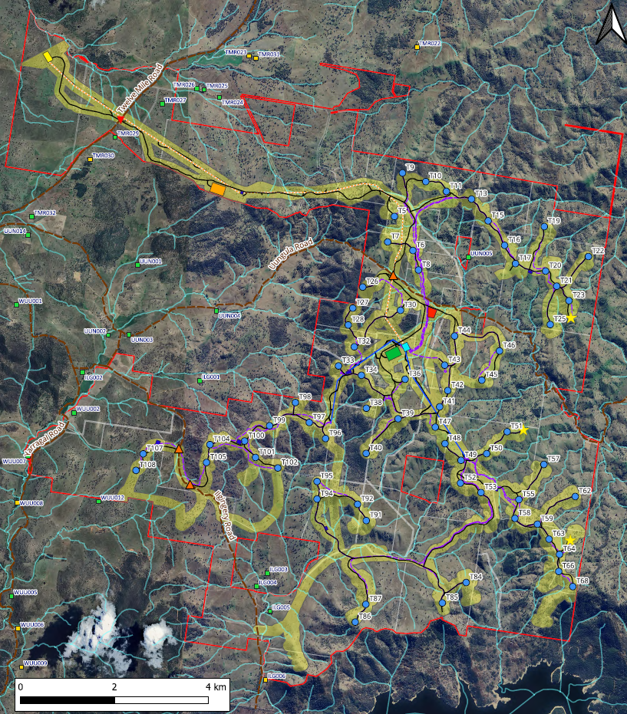
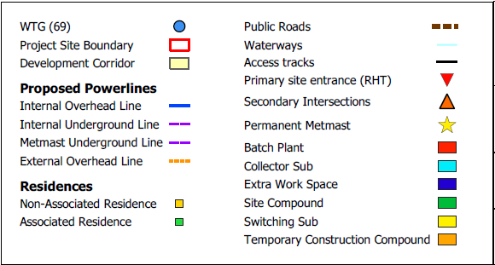
Current Layout Plan
Dan Banovic
69x 6.0MW WTGs = 414MW
Central collector substation
Switching station north of Twelve Mile Road on existing transmission line
Battery deferred to a later stage
Main access off Twelve Mile Road
Secondary intersections are for cross-overs only

Slide 7
2. Project Update – Wind Farm Works
Public Road Upgrades
Q1 – Q3 2024
Wind Farm Civil Works
Q3 2024 – Q2 2026
WTG Installation
Q4 2025 – Q4 2026
WTG Energisation & Handover
Q3 2026 – Q1 2027
Anticipated Practical Completion
Q1 2027
SQE Operations Team operate the Wind Farm ~30 years
Dan Banovic

Slide 8
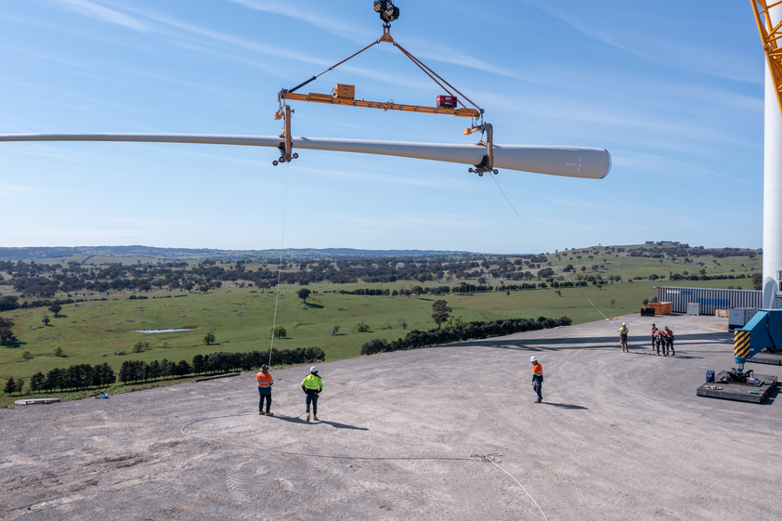
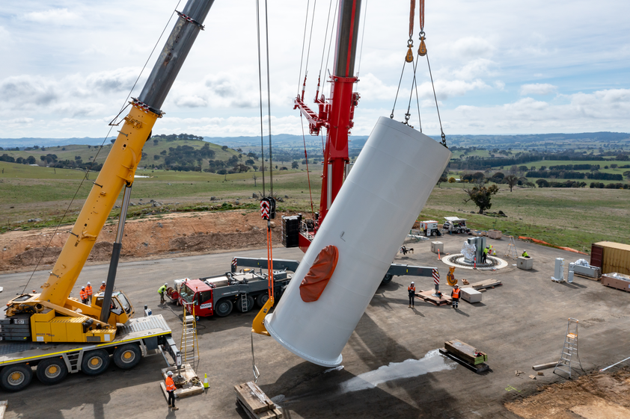
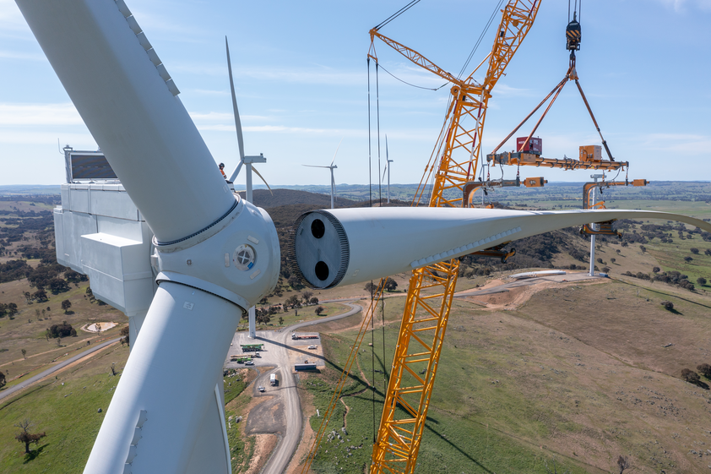
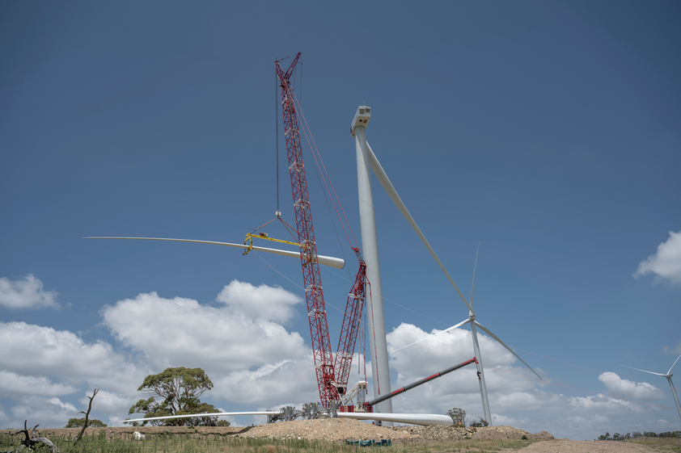

Slide 9
3. Terms of Reference
Garry West
Requirement of the NSW Department of Planning of all CCCs
Important for governance
Ensures consistency

Slide 10
4. Environmental Approval Conditions
Sheree Kidziak
Project is State Significant Development.
NSW Development Consent – Modification 2 (SSD-6687) - Approval from NSW Planning Minister – Conditions of Approval available on website.
Commonwealth EPBC (Environmental Protection and Biodiversity Conservation) Act Approval (2013/7026) - Conditions of Approval available on website.
Approved management plans available on website:
    Final Layout Plan (v2)
    Environmental Management Strategy (v4)
    Traffic Management Plan (v3)
    Biodiversity Management Plan (v5)
    Heritage Management Plan (v4)
    Emergency Plan (v1)
    Accommodation and Employment Strategy (v0)

Slide 11
4. Monitoring, Audit and Environmental compliance
Sheree Kidziak
Pre-construction dilapidation survey report – completed November 2022
EPBC Annual compliance report – 2022 and 2023- completed
CCC will have environmental reporting on each agenda

Slide 12
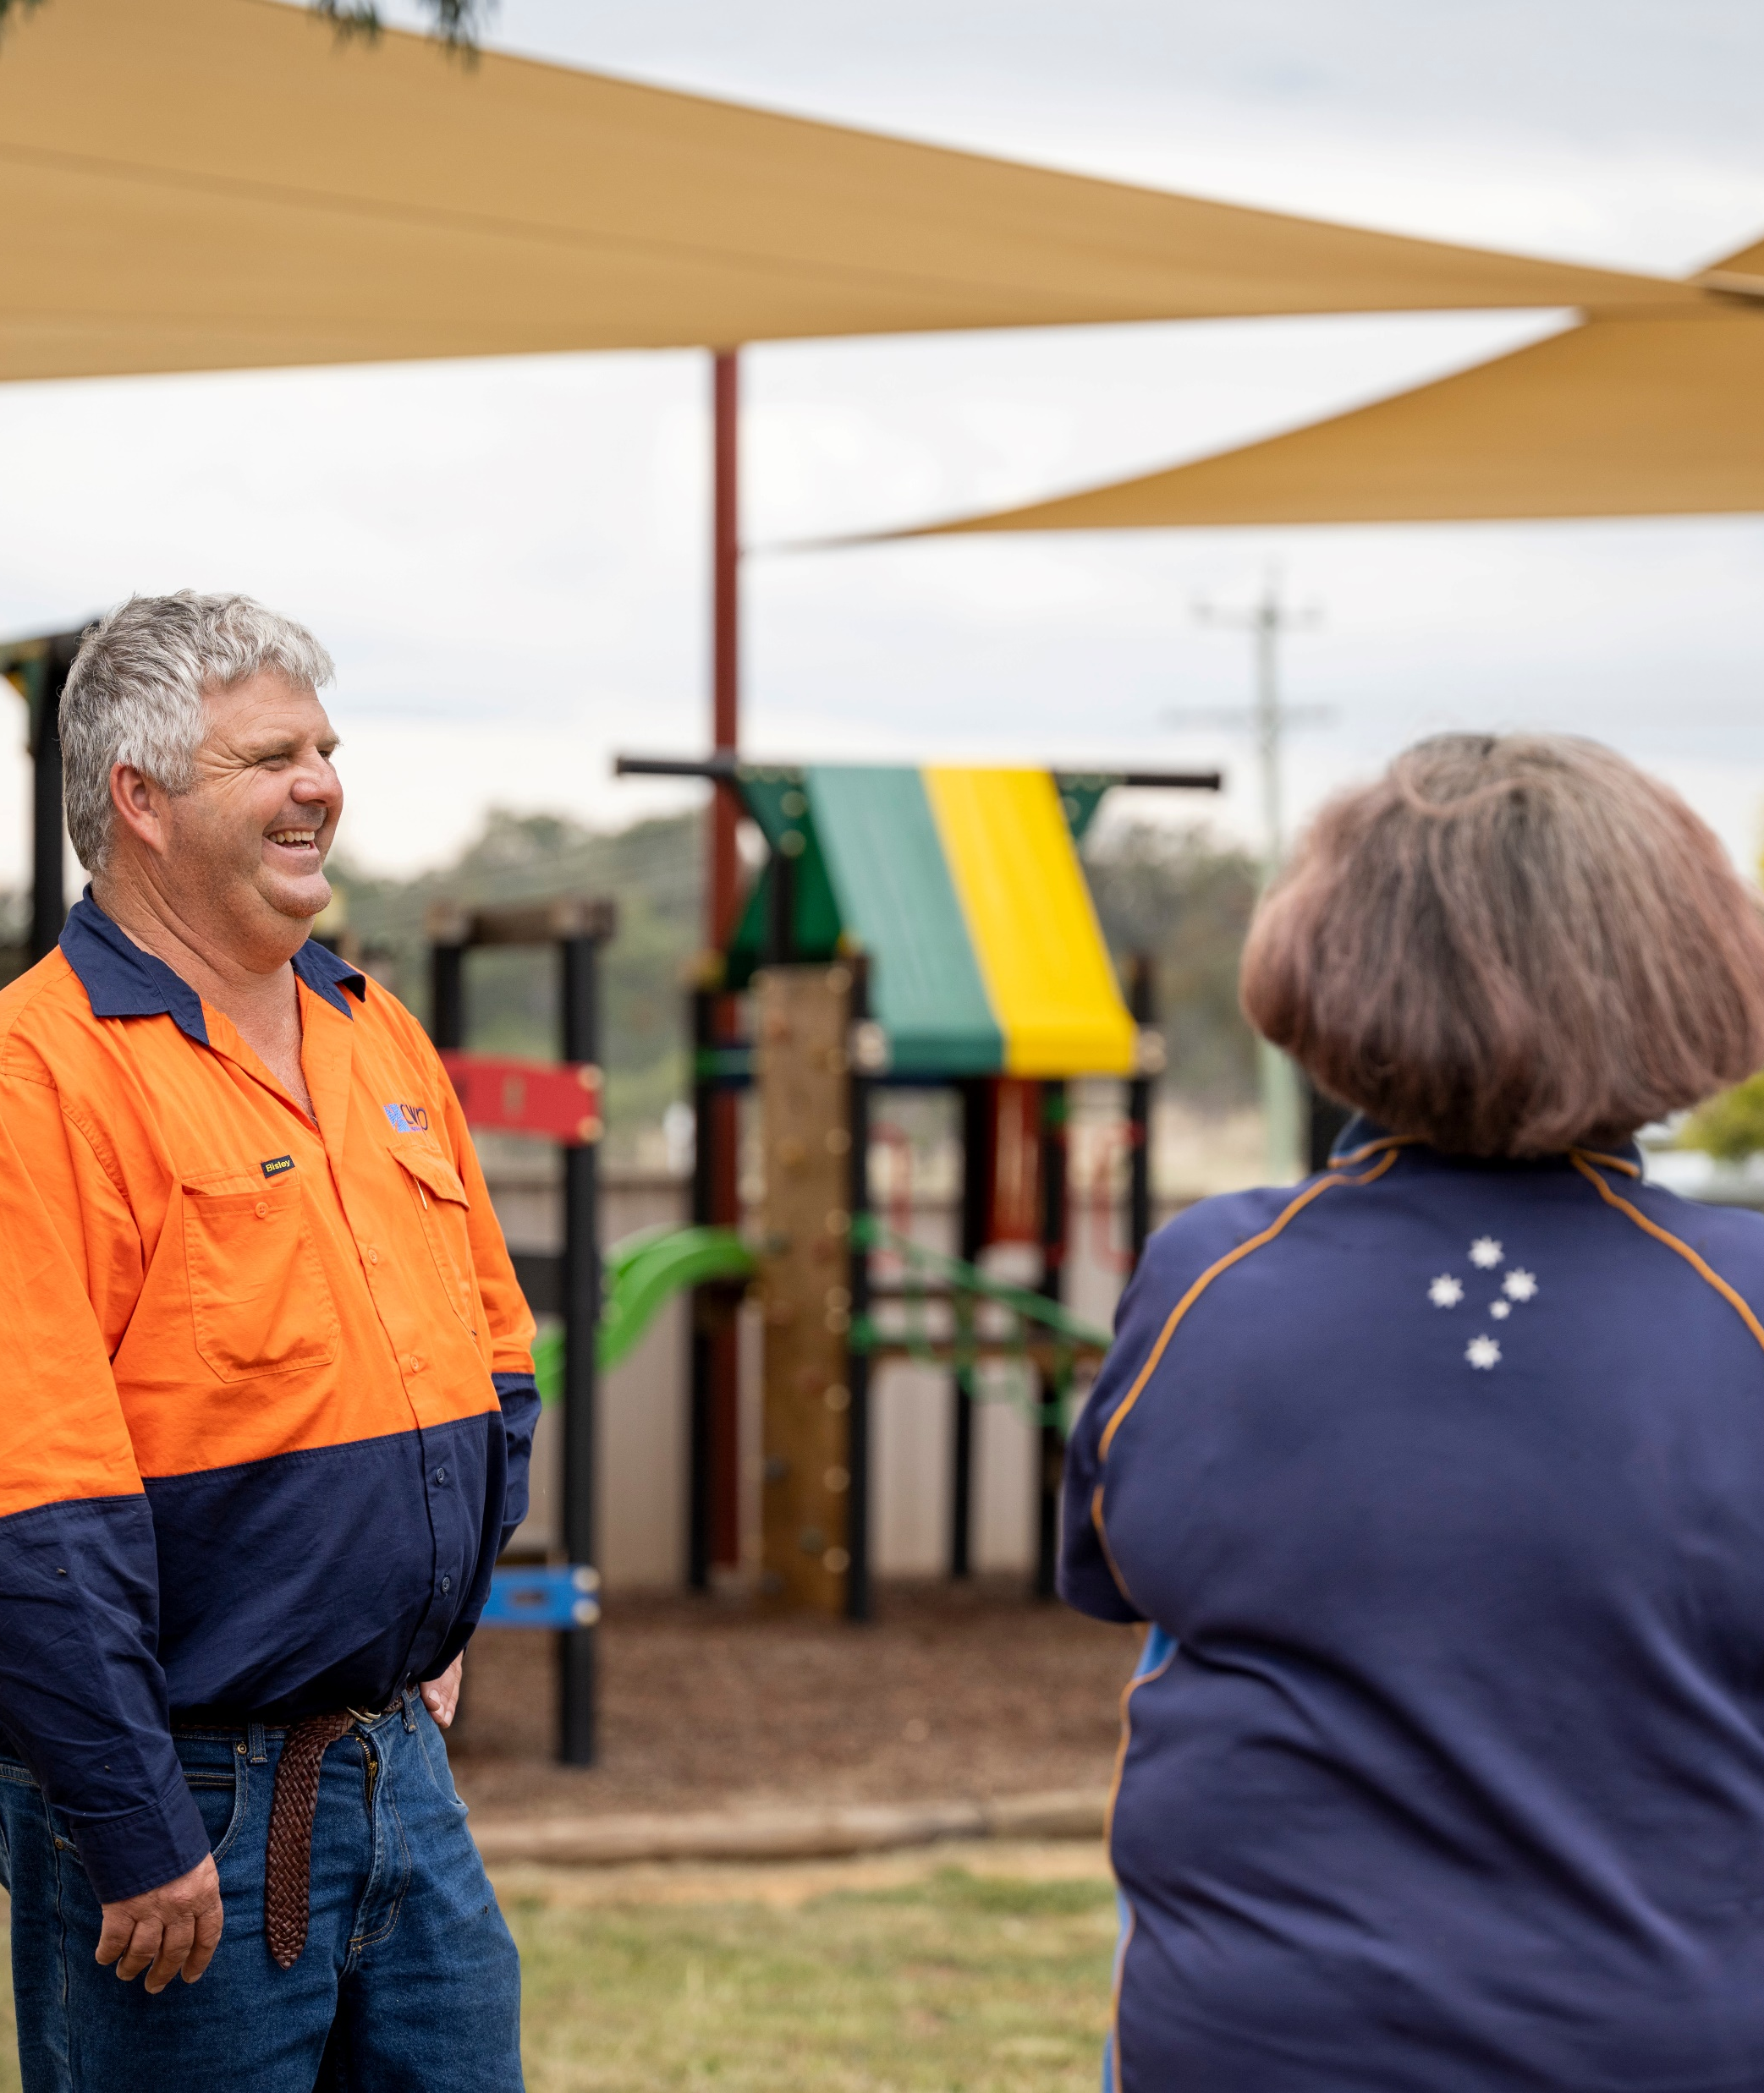
5. Community Engagement Update -Kath Elliott
Project will have a dedicated community engagement resource for next year to ensure our social licence obligations are met
Community sponsorship program to support Wellington community
Co investment program to allow local people invest in the project with guaranteed returns and some matching seed funding.
Squadron Link – city speed wifi network for farmers and neighbours

Slide 13
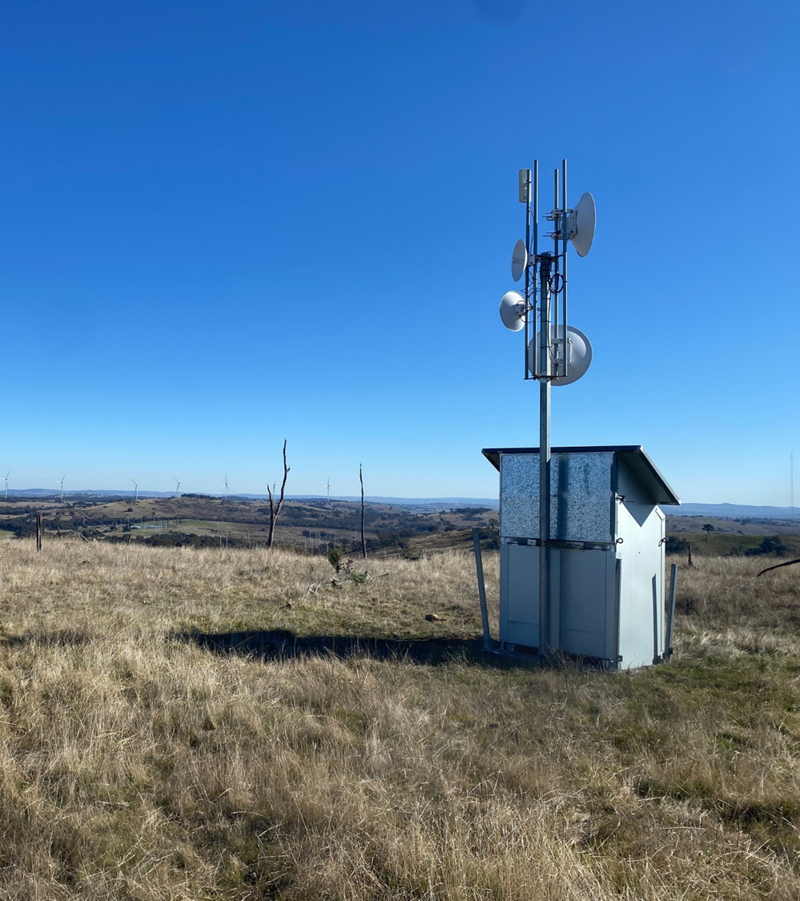
6. Community benefit initiatives
Squadron Link – Matt Flower
Approaching landowners near Uungula Wind Farm seeking interest in fast and reliable internet.
Squadron Link will enable farmers to adopt agricultural technology (agtech) solutions.
Up to $2,500 worth of agtech to qualifying farmers for the deployment of agtech solutions on their land.
Once network is deployed, SQE will subsidise, leading to a fully supported network at an anticipated cost of $40/month.
SQE will provide free service for the first 2 years while establishing network.

Slide 14
Meeting administration
Discussion
Meeting frequency
General business
Date of next meeting

